Slide 1

“ There were 5 Billion GB of information created between the dawn of civilization through 2003, but that much information is now created every 60 hours !!!!!”
Eric Schmidt
Former Executive Chairman at Google
INTRUDUCTION TO DATA SCIENCE
- by Kunal Kalkotwar

Slide 2

LEARNING OBJECTIVES
What is meant by the term “Data Science”.
Apprehend the field of Data Science’s impact and importance in society.
Its Application, Importance and Advantage in various industries.
How does data science impact organizations?
Basic Steps for learning Data Science

Slide 3
WHAT IS DATA SCIENCE ?
DATA
SCIENCE
Facts and statistics collected together for reference or analysis.
The intellectual and practical study of natural and physical world.
Data Science is the field of science in which we deal with the various forms of data to get and develop some informative insights for business development and research.

Slide 4
WHY DATA SCIENCE IS A BOOMING INDUSTRY OF 21ST CENTURY
Data in the 21st Century is like oil in the 18th Century.
Per day “2,50,00,00,000 GB” of data is created and this number is in increasing order.
For handling such a huge amount of data, data scientists are in high demand as they bring a rare mix of strong data knowledge, business awareness, technological skills, intuition and statistical expertise.

Slide 5
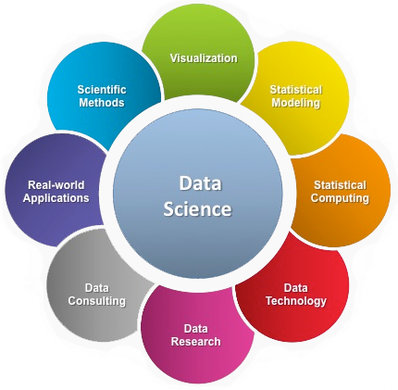
MORE ABOUT DATA SCIENCE…
A multi-directional field that uses scientific methods, processes, algorithms and systems to extract knowledge and insights from structured and unstructured data.
Image Credit: Google

Slide 6
WHAT DATA SCIENCE INCLUDES
Statistics
Business Analytics
Big Data Analytics
Data(base) Management
Data Visualization
Data Mining
Machine Learning
Deep Learning
Artificial Intelligence

Slide 7

WHAT DO PEOPLE LOOK FOR IN A DATA SCIENTIST ?
Passion and Curiosity
Mental Capacity
Ability to translate ML Problems
Automation and optimization
Personality & Team Fit
Coding Experience
Debugging Skills
Adaptability
Full Stack potential
Storytelling

Slide 8

BASICS STEPS FOR LEARNING DATA SCIENCE
Python for Data Science
Data Analytics
Machine Learning
Deep Learning
Artificial Intelligence

Slide 9
CLASSIFICATION OF AI SYSTEMS WITH RESPECT TO ENVIRONMENT
AI systems can be classified based on their interaction with the environment.
This includes Reactive Machines, Limited Memory, Theory of Mind, and
Self-Aware Systems.
Reactive Machines operate based on predefined rules and do not possess memory.
Limited Memory Systems, like self-driving cars, use past data for decision-making.
Theoretical Models of mind attempt to give AI systems the ability to understand human emotions and intentions.
Self-Aware Systems can recognize their existence and adapt accordingly.
AI systems with a sense of a theory of mind can understand and predict human behaviour.

Slide 10
ARTIFICIAL INTELLIGENCE VS MACHINE LEARNING
While AI is a broader concept, machine learning is a subset that focuses on training models to make predictions or decisions. It involves Supervised and Unsupervised learning methods.
AI encompasses a broader range of technologies, including Robotics, Natural Language Processing, and Computer Vision.
Machine learning involves training models on data to make predictions or decisions without explicit programming.
Supervised learning requires labelled data for training, while unsupervised learning identifies patterns without labelled data.
Deep learning, a subset of machine learning, involves neural networks with multiple layers for complex tasks.
AI and machine learning are used in tandem to create intelligent systems capable of learning and adapting.

Slide 11
DATA SCIENCE LIFE CYCLE
Business Objective
Data Requirement
Data Collection
Exploratory Data Analysis
Modelling
Evaluation
Deployment
Monitoring

Slide 12

VARIOUS DATA SCIENCE JOB ROLES
Data Analyst
Business Analyst
Data Engineer
Statistician
Data Admin.
Data and Analytics Manager
Data Scientist
Data Architect
Machine Learning Engineer
Research Data Scientist

Slide 13
APPLICATION OF DATA SCIENCE IN VARIOUS DOMAINS
Cyber Security
Sports
Banking and Finance
Internet Search
Digital Advertisement
Recommender System
Image Processing
Speech Recognition
Gaming
Price Comparison Website
Airlines Routing Planning
Fraud and Risk Detection
Delivery Logistics
Ecommerce
Internet of Things (IoT)
Health care
Robotics and Autonomous vehicle development
Automobile and Mechanical Engineering
Civil and Architecture Engineering
Augmented Reality
OTT Platforms
Banking Sector, and many more….

Slide 14
IMPORTANCE OF DATA SCIENCE IN AN INDUSTRY
Data science helps brands to understand their customers in a much more enhanced and empowered manner.
It allows brands to communicate their story engagingly and powerfully.
Big Data is an old field which is now constantly growing and evolving.
Its findings and results can be applied to almost any sector like travel, healthcare and education among others.
Data science is accessible to almost all sectors.

Slide 15


